Slide 1


Cazamariposas: Automated Instability Debugging in SMT-based Program Verification
Yi Zhou, Amar Shah, Zhengyao Lin, Marijn Heule, Bryan Parno
Notes:
Say Z3 instead of “the solver”
Two fixes for stability: either stabilize solver, or stabilize the query (we take the second approach)
Need to have an overview at the beginning
Need to mention instability caused by quantifiers
Bring up close to the start that there are two failure modes (follows the triage)
Talk about quantifiers early!!! (someone might ask why we focused on quantifiers)

Slide 2









Challenge with Scaling SMT-based verification
Verus
F*
Viper
Success: proof completed ✅
I do formal verification
Dafny
Why3
Program
SMT Query
Verifier
SMT Solver
Renaming
Variable
Renaming
Variable
Failure: proof not found ❌
Program’
SMT Query’
Verifier
SMT Solver
my_var should be called myVar!!!
Notes:
Put Viper and Why3 back in
Bubble Z3 and cvc5 for SMT solvers
Bernardo: maybe move this after the next slide
1 slide to set up the problem, 1 slide to see why this is such a big problem, 1 slide for what Cazamariposas changes
Animate in Cazamariposas instead of the spinning cat (takes input and produces smt query’’ (maybe add a third row)
Emphasize that it stabilizes the query
Maybe as a separate slight (include key insights) -> after motivation screenshots

Slide 3
Challenge with Scaling SMT-based verification
Success: proof completed ✅
Program
SMT Query
Verification
Framework
SMT Solver
-Program verification is generally undecidable.
- SMT solvers can fail to find a solution
Renaming
Variable
Renaming
Variable
Failure: proof not found ❌
Program’
SMT Query’
Verification
Framework
SMT Solver

Slide 4
Challenge with Scaling SMT-based verification
Program
SMT Query
Verifier
SMT Solver
Program verification is generally undecidable.
If there is information missing, SMT solvers are allowed to give up.
Renaming
Variable
Renaming
Variable
Failure: proof not found ❌
Program’
SMT Query’
Verifier
SMT Solver
Stabilize Program
Success: query stabilized 🔒
Program’’
SMT Query’’
Verifier
SMT Solver
Notes:
Bernardo: maybe move this after the next slide
1 slide to set up the problem, 1 slide to see why this is such a big problem, 1 slide for what Cazamariposas changes
Animate in Cazamariposas instead of the spinning cat (takes input and produces smt query’’ (maybe add a third row)
Emphasize that it stabilizes the query
Maybe as a separate slight (include key insights) -> after motivation screenshots

Slide 5
Proof Instability (Brittleness)
Trivial changes to the program
may cause spurious failures in
SMT-based verification.
Notes:
I went very quick here. Give it a bit more time

Slide 6
Solution to instability
Success: proof completed ✅
UNSTABLE 🦋
Program
SMT Query
Verifier
SMT Solver
Renaming
Variable
Renaming
Variable
Failure: proof not found ❌
UNSTABLE 🦋
Program’
SMT Query’
Verifier
SMT Solver
Stabilize Program
Success: proof completed ✅
STABLE 🔒
Program’’
SMT Query’’
Verifier
SMT Solver
Notes:
Explain what stable means!

Slide 7
Motivation
Causes of Instability
Two Types of Instability
Query Edits
Preserve Verification Goal
Evaluation
Notes:
went way too quick on this. Start with nothing and introduce all of teh sections Marijn: Went way too quick on this
Bernardo: Use this for the next usage of this slide. Audience might zone out

Slide 8
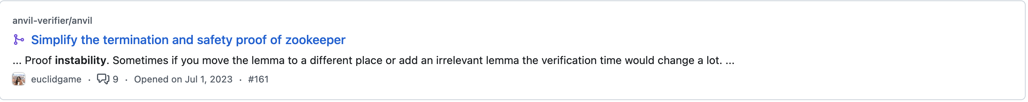


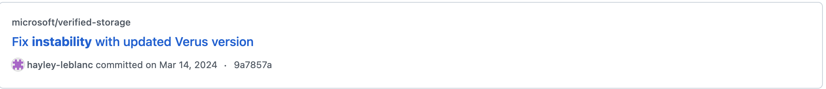
Instability Wastes Time for Developers
Ugh my program is unstable :(
8

Slide 9
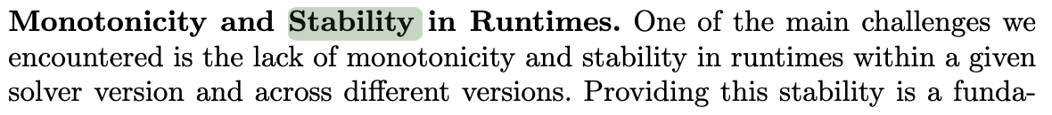

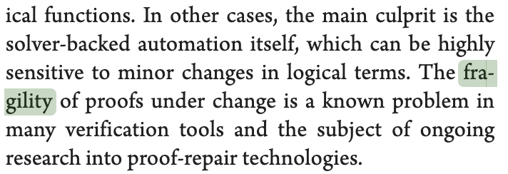

Major Roadblock for Industrial Verification

Slide 10
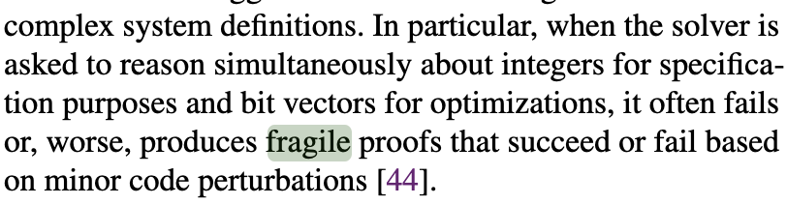
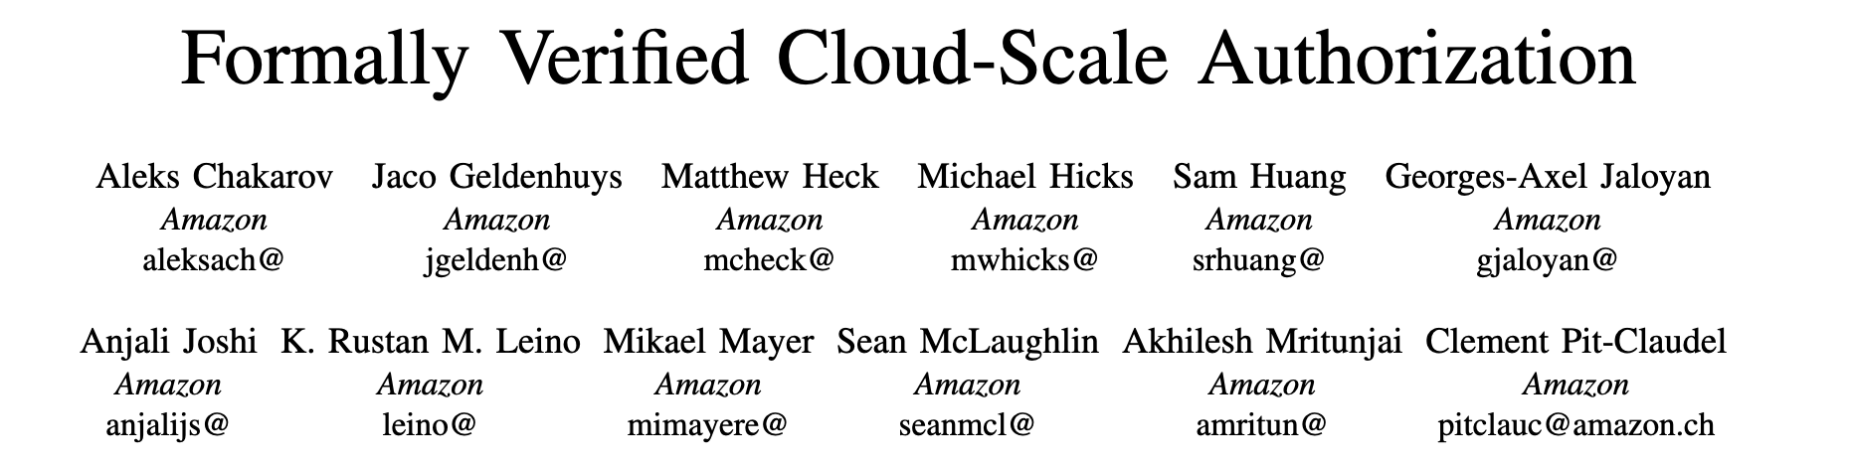
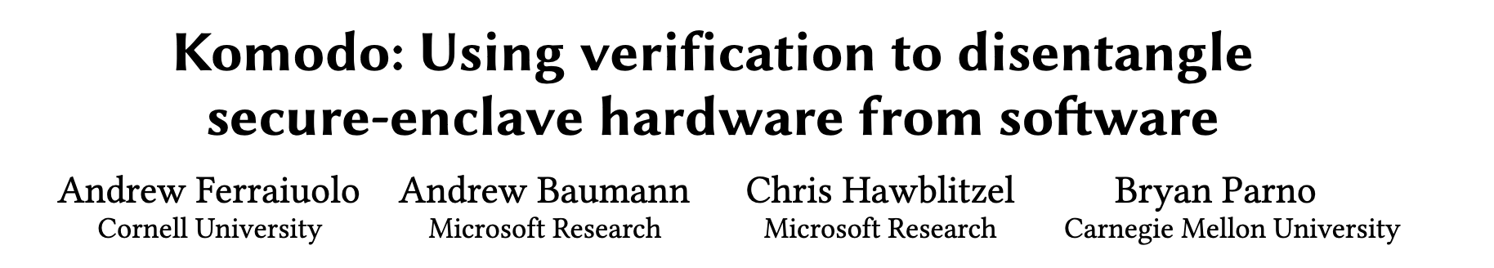
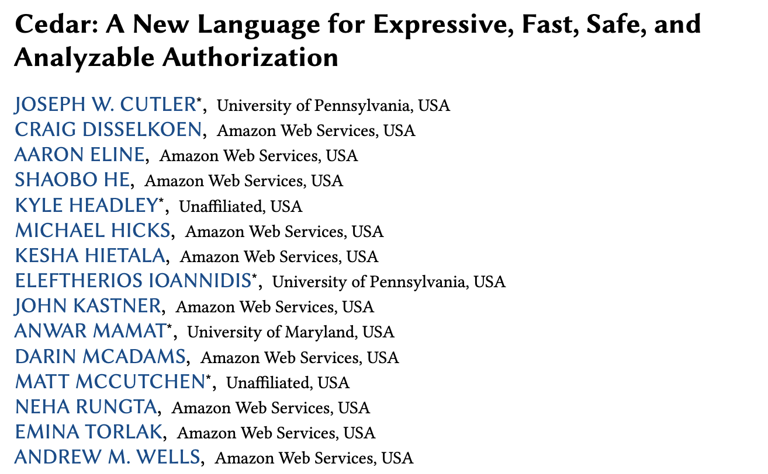
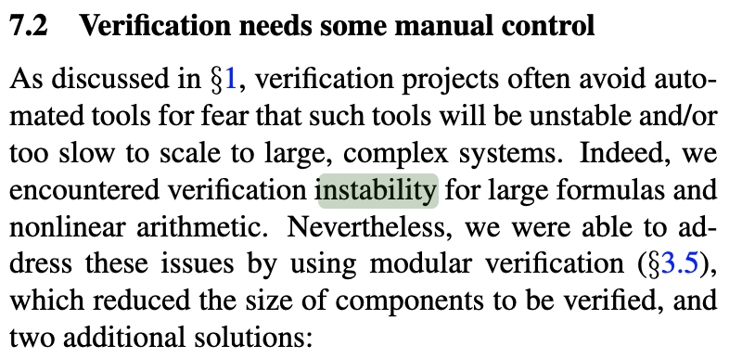
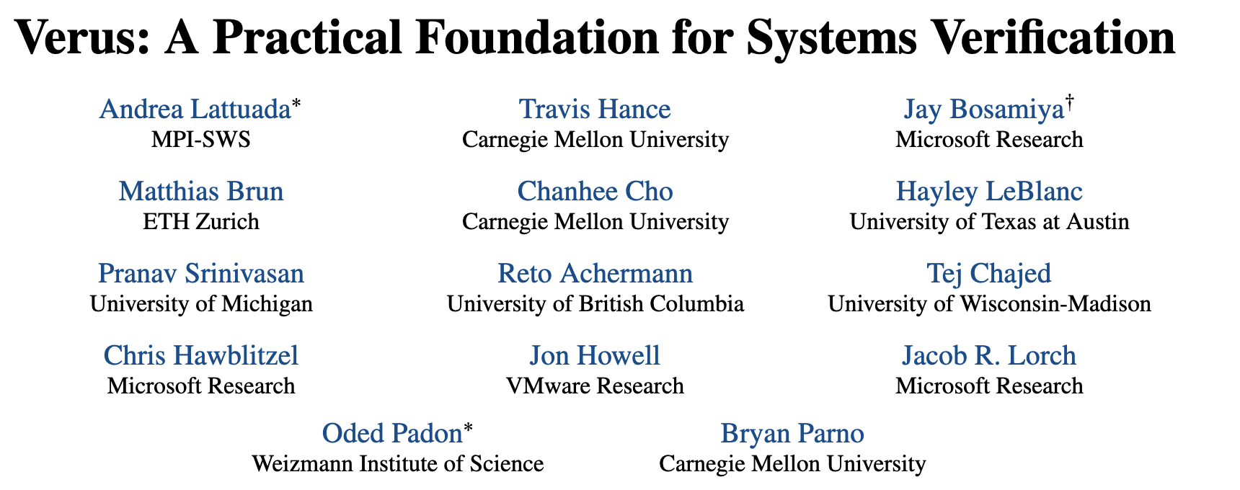
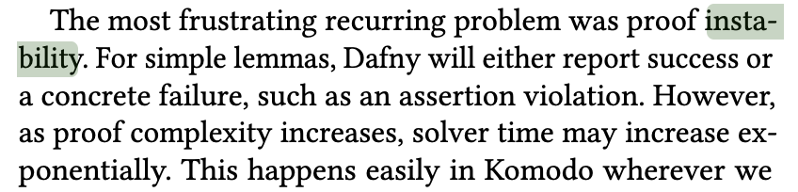
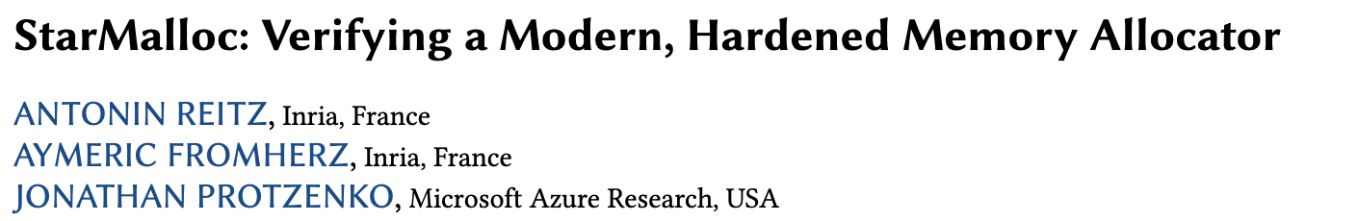

Major Roadblock for Academic Verification
Almost every paper using Dafny/Verus/F* has a subsection about instability!

Slide 11
Cazamariposas Vision
Ugh my program is unstable :(
Yay my program is stable 🔒
(assert (forall ((x Poly)) (! (=> (has_ ...
...
(assert (forall ((bits Int) (x Poly)) (!...
(assert (forall ((bits Int) (x Poly)) (!...
(assert (forall ((x Int)) (! (= (str%fro...
(assert (forall ((x StrSlice)) (! (has_ ...
(assert (forall ((x@ tuple%0.)) (! (= x@...
(assert (not (=> (= temp_0_0~17@ (Mul b~...
(check-sat)
Verifier
Proposed Fix
Notes:
Make this a contribution slide
This is a hard problem: you only need to fix a quantifier
After this: Ven diagrams -> graphs -> ven diagrams

Slide 12
Cazamariposas Contribution
Identifies an edit that stabilizes the query on 60% of benchmarks
Proposes two different classes of unstable queries (timeouts and fast unknowns) and designs distinct edits for each
The edits are small, and based on instantiating or deleting a single quantified axiom at the SMT level
Notes:
Make this a contribution slide
This is a hard problem: you only need to fix a quantifier
After this: Ven diagrams -> graphs -> ven diagrams

Slide 13
Motivation
Causes of Instability
Two Types of Instability
Query Edits
Preserve Verification Goal
Evaluation
Notes:
Go 17 -> 19 (source) -> 18 -> 21 … 25 -> 20 (source)

Slide 14
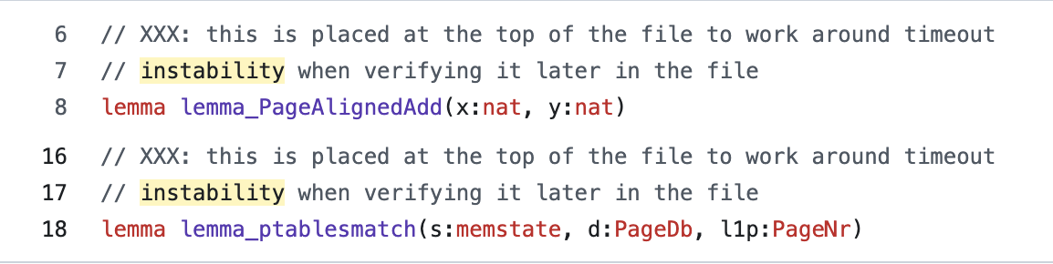
Source Level: How Does Instability Manifest?
1. Revealing/Hiding Functions
These are symptoms of an underlying problem in the solver
Ugh my program is unstable :(
2. Renaming Variables
3. Order of Assertions
Notes:
Very little difference between yellow and white. Use a different colo rto make it stand out
Talk about quantifiers, then we can talk about the two failure modes after this
The actual reason is the two possible cases (don’t compare to Shake)
Context pruning is important to emphasize
Get rid of solver versions
These are “triggers of instability from the users perspective”
Emphasize these are not the actual causes
We fix the actual cause!!

Slide 15
SMT Level: Quantifiers Major Cause of Instability
(assert (forall ((x Poly)) (! (=> (has_ ...
...
(assert (forall ((bits Int) (x Poly)) (!...
(assert (forall ((bits Int) (x Poly)) (!...
(assert (forall ((x Int)) (! (= (str%fro...
(assert (forall ((x StrSlice)) (! (has_ ...
(assert (forall ((x@ tuple%0.)) (! (= x@...
(assert (not (=> (= temp_0_0~17@ (Mul b~...
(check-sat)
- Reasoning about quantifiers is notoriously difficult.
- SMT solvers use patterns.
Notes:
Talk about pattern-based matching
Don’t imply that we don’t use existentials
Be careful about saying undecidable
Be clear why deleting quantifiers is a good idea
Very little difference between yellow and white. Use a different colo rto make it stand out
Talk about quantifiers, then we can talk about the two failure modes after this
The actual reason is the two possible cases (don’t compare to Shake)
Context pruning is important to emphasize
Get rid of solver versions
These are “triggers of instability from the users perspective”
Emphasize these are not the actual causes
We fix the actual cause!!

Slide 16
SMT Level: Quantifiers Sensitive to Chosen Pattern
(assert (forall ((x A)) (f (g x)) :pattern (g x)))
(assert (g t))
(assert (f (g t)))
(assert (forall ((x A)) (f (g x)) :pattern (f (g x))))
(assert (g t))
No instantiations!

Slide 17
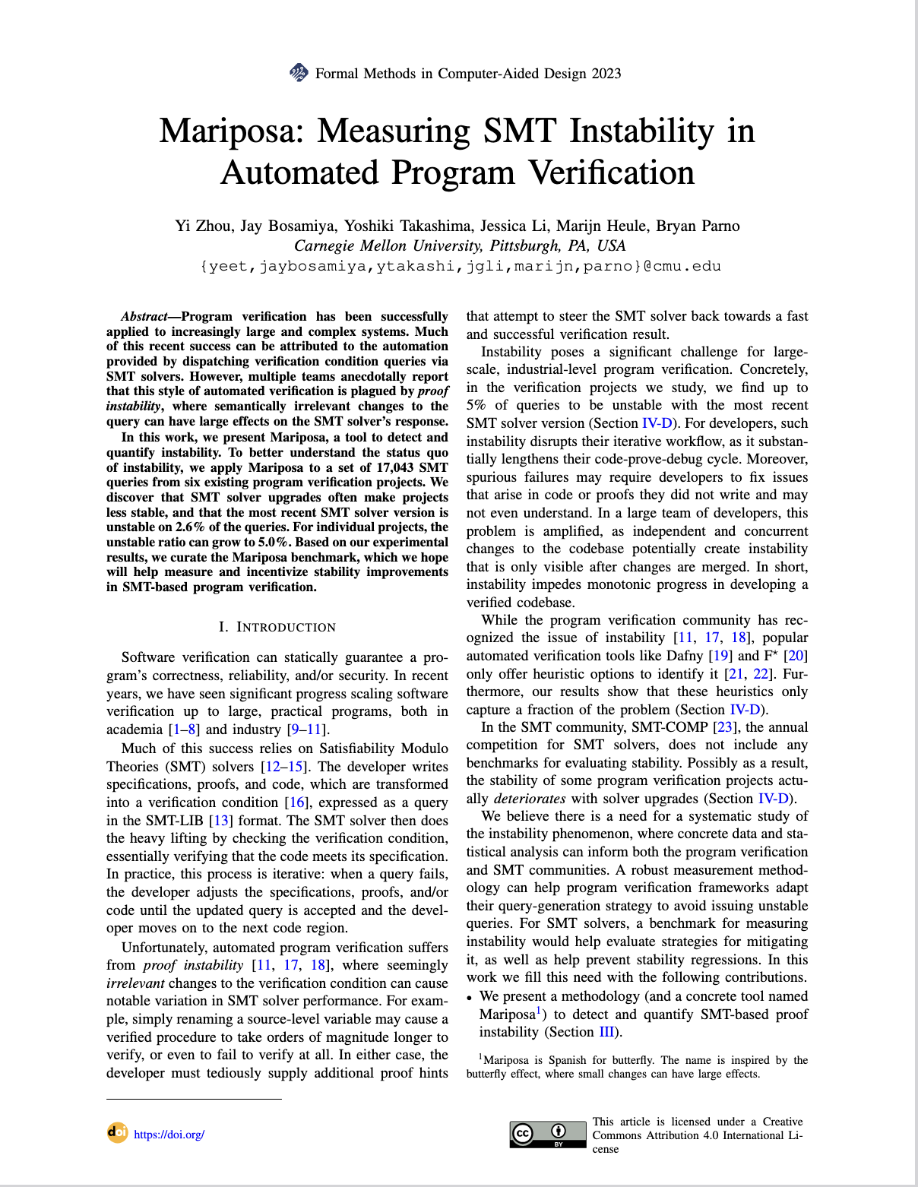
Mariposa: Measuring SMT Instability [Zhou et al. 2023]
A tool for detection & measurement.
A benchmark for evaluation (Dafny, F*)
Found 2.6% of SMT queries are unstable
Notes:
- dot after the et al
'23 and 2024 for shake (make consistent)
Worth showing the statistical test chart (makes Mariposa seem non-trivial)
Verus benchmarks have 0.9% unstable

Slide 18
Mariposa in a Nutshell
Ex: rename/shuffle
Mutant 1
SMT Query
Mutant 2
Mariposa
SMT Solver
Mutant 3

Slide 19

Mariposa Stability Categories
Mutant Success Rate:
% of the mutants that succeed
unsolvable
unstable
stable
0%
100%
Notes:
Add stat tests

Slide 20
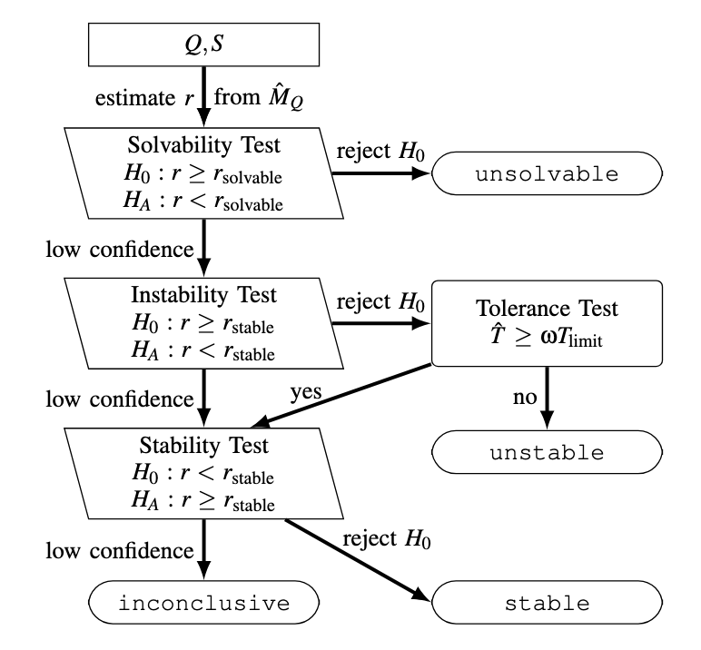
Mariposa: Rigorous Statistical Test

Slide 21
Background
Causes of Instability
Two Types of Instability
Query Edits
Preserve Verification Goal
Evaluation

Slide 22
Hypothesis: Two Different Causes of Instability
Solver discovers too many instantiations
Solver misses instantiations
Solver-Discovered
Instantiations
Solver-
Discovered
Instantiations
Required
Instantiations
= ∅
Required
Instantiations
Output: Solver times out
Output: Solver returns quick “unknown”

Slide 23
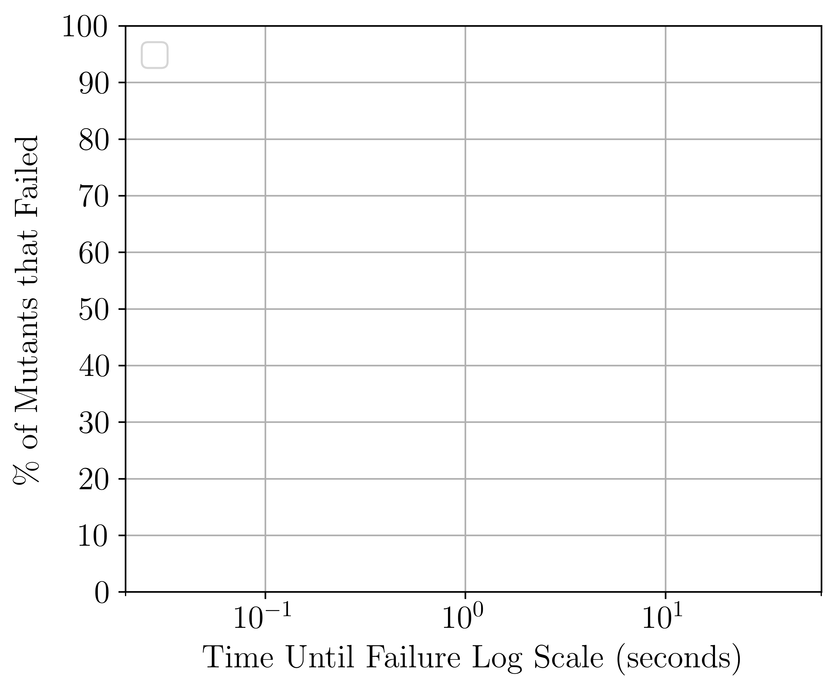
Experiment: Distinct Failure Modes
Notes:
Discuss axes before

Slide 24
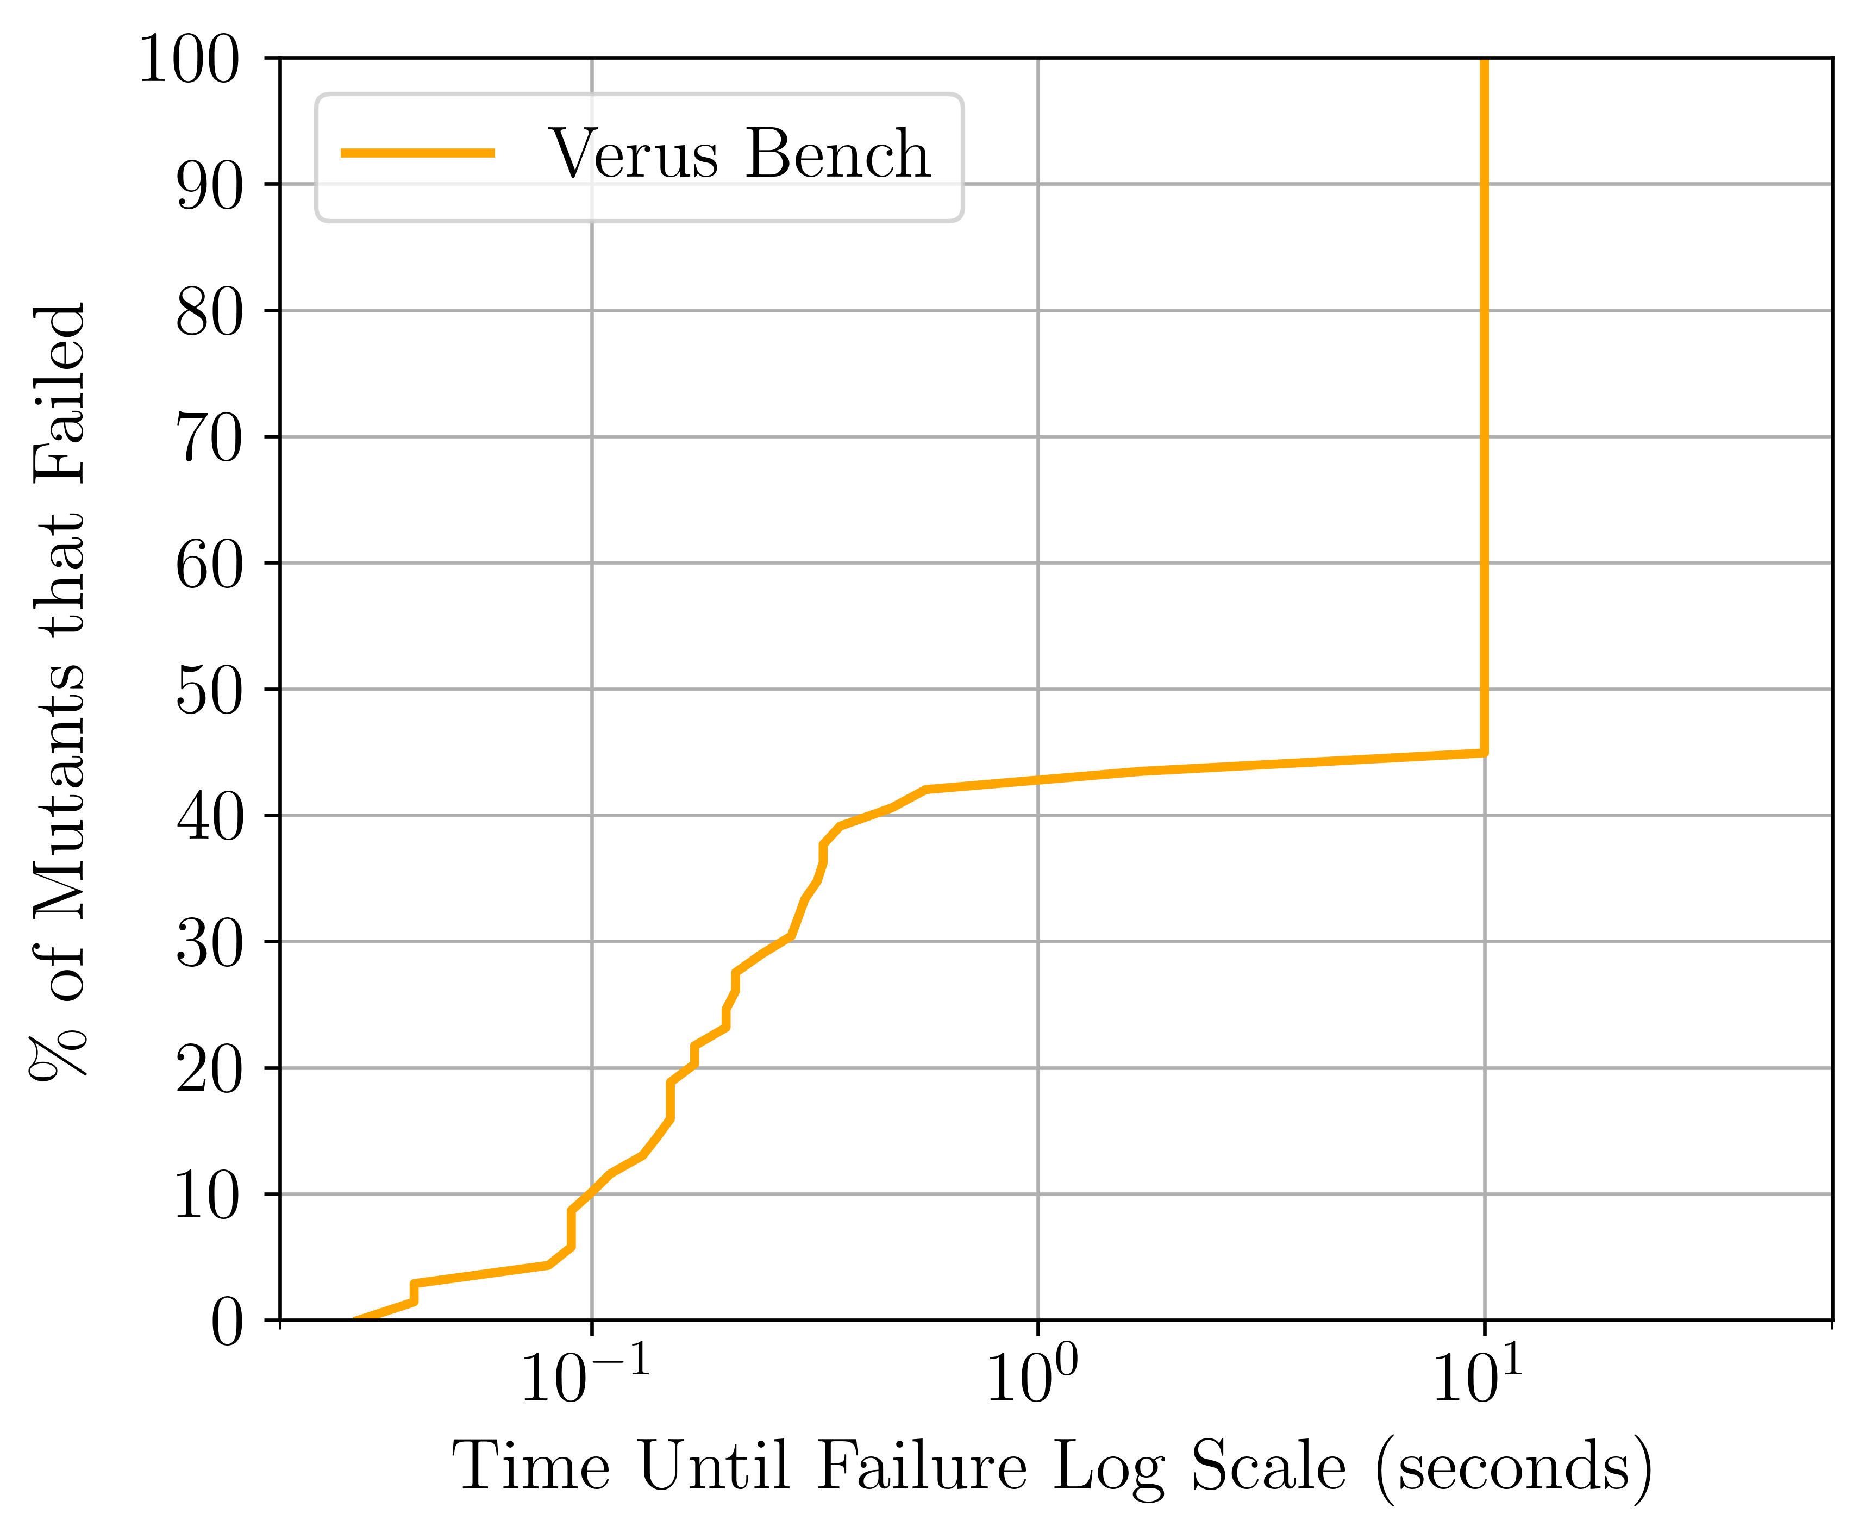
Experiment: Distinct Failure Modes
Notes:
Give the graph a lot of time
- just do one of Verus or Mariposa
Scripts are on 1905

Slide 25
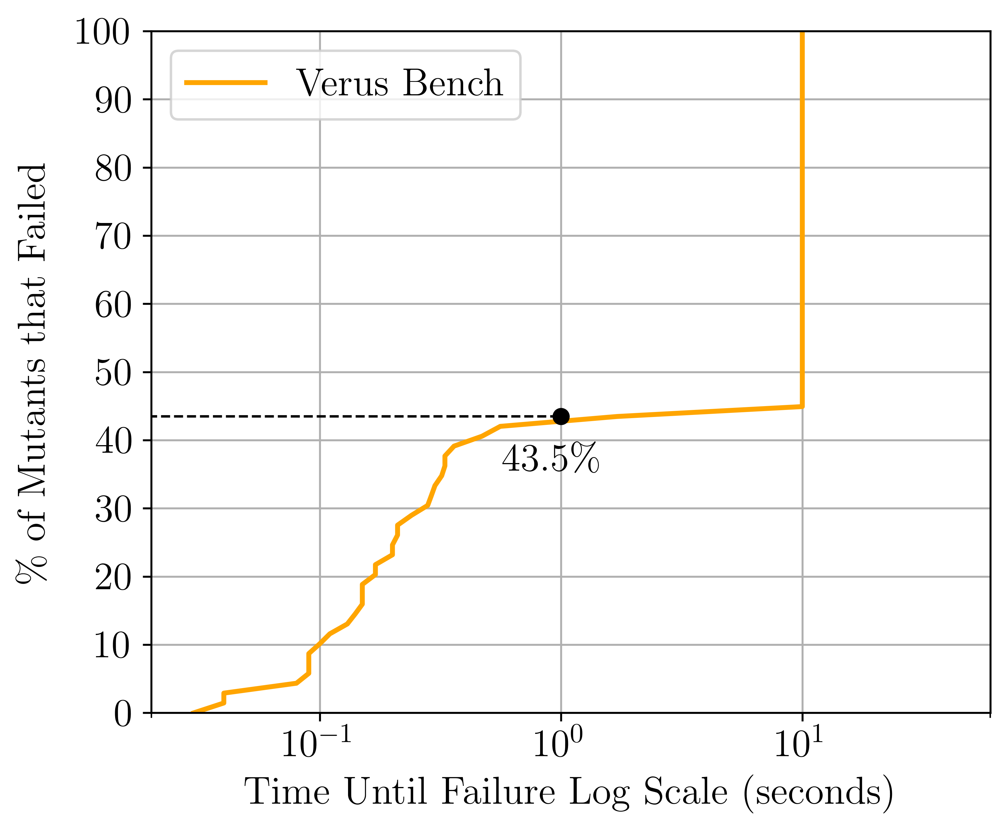
Experiment: Distinct Failure Modes
Notes:
Give the graph a lot of time
- just do one of Verus or Mariposa
Scripts are on 1905

Slide 26
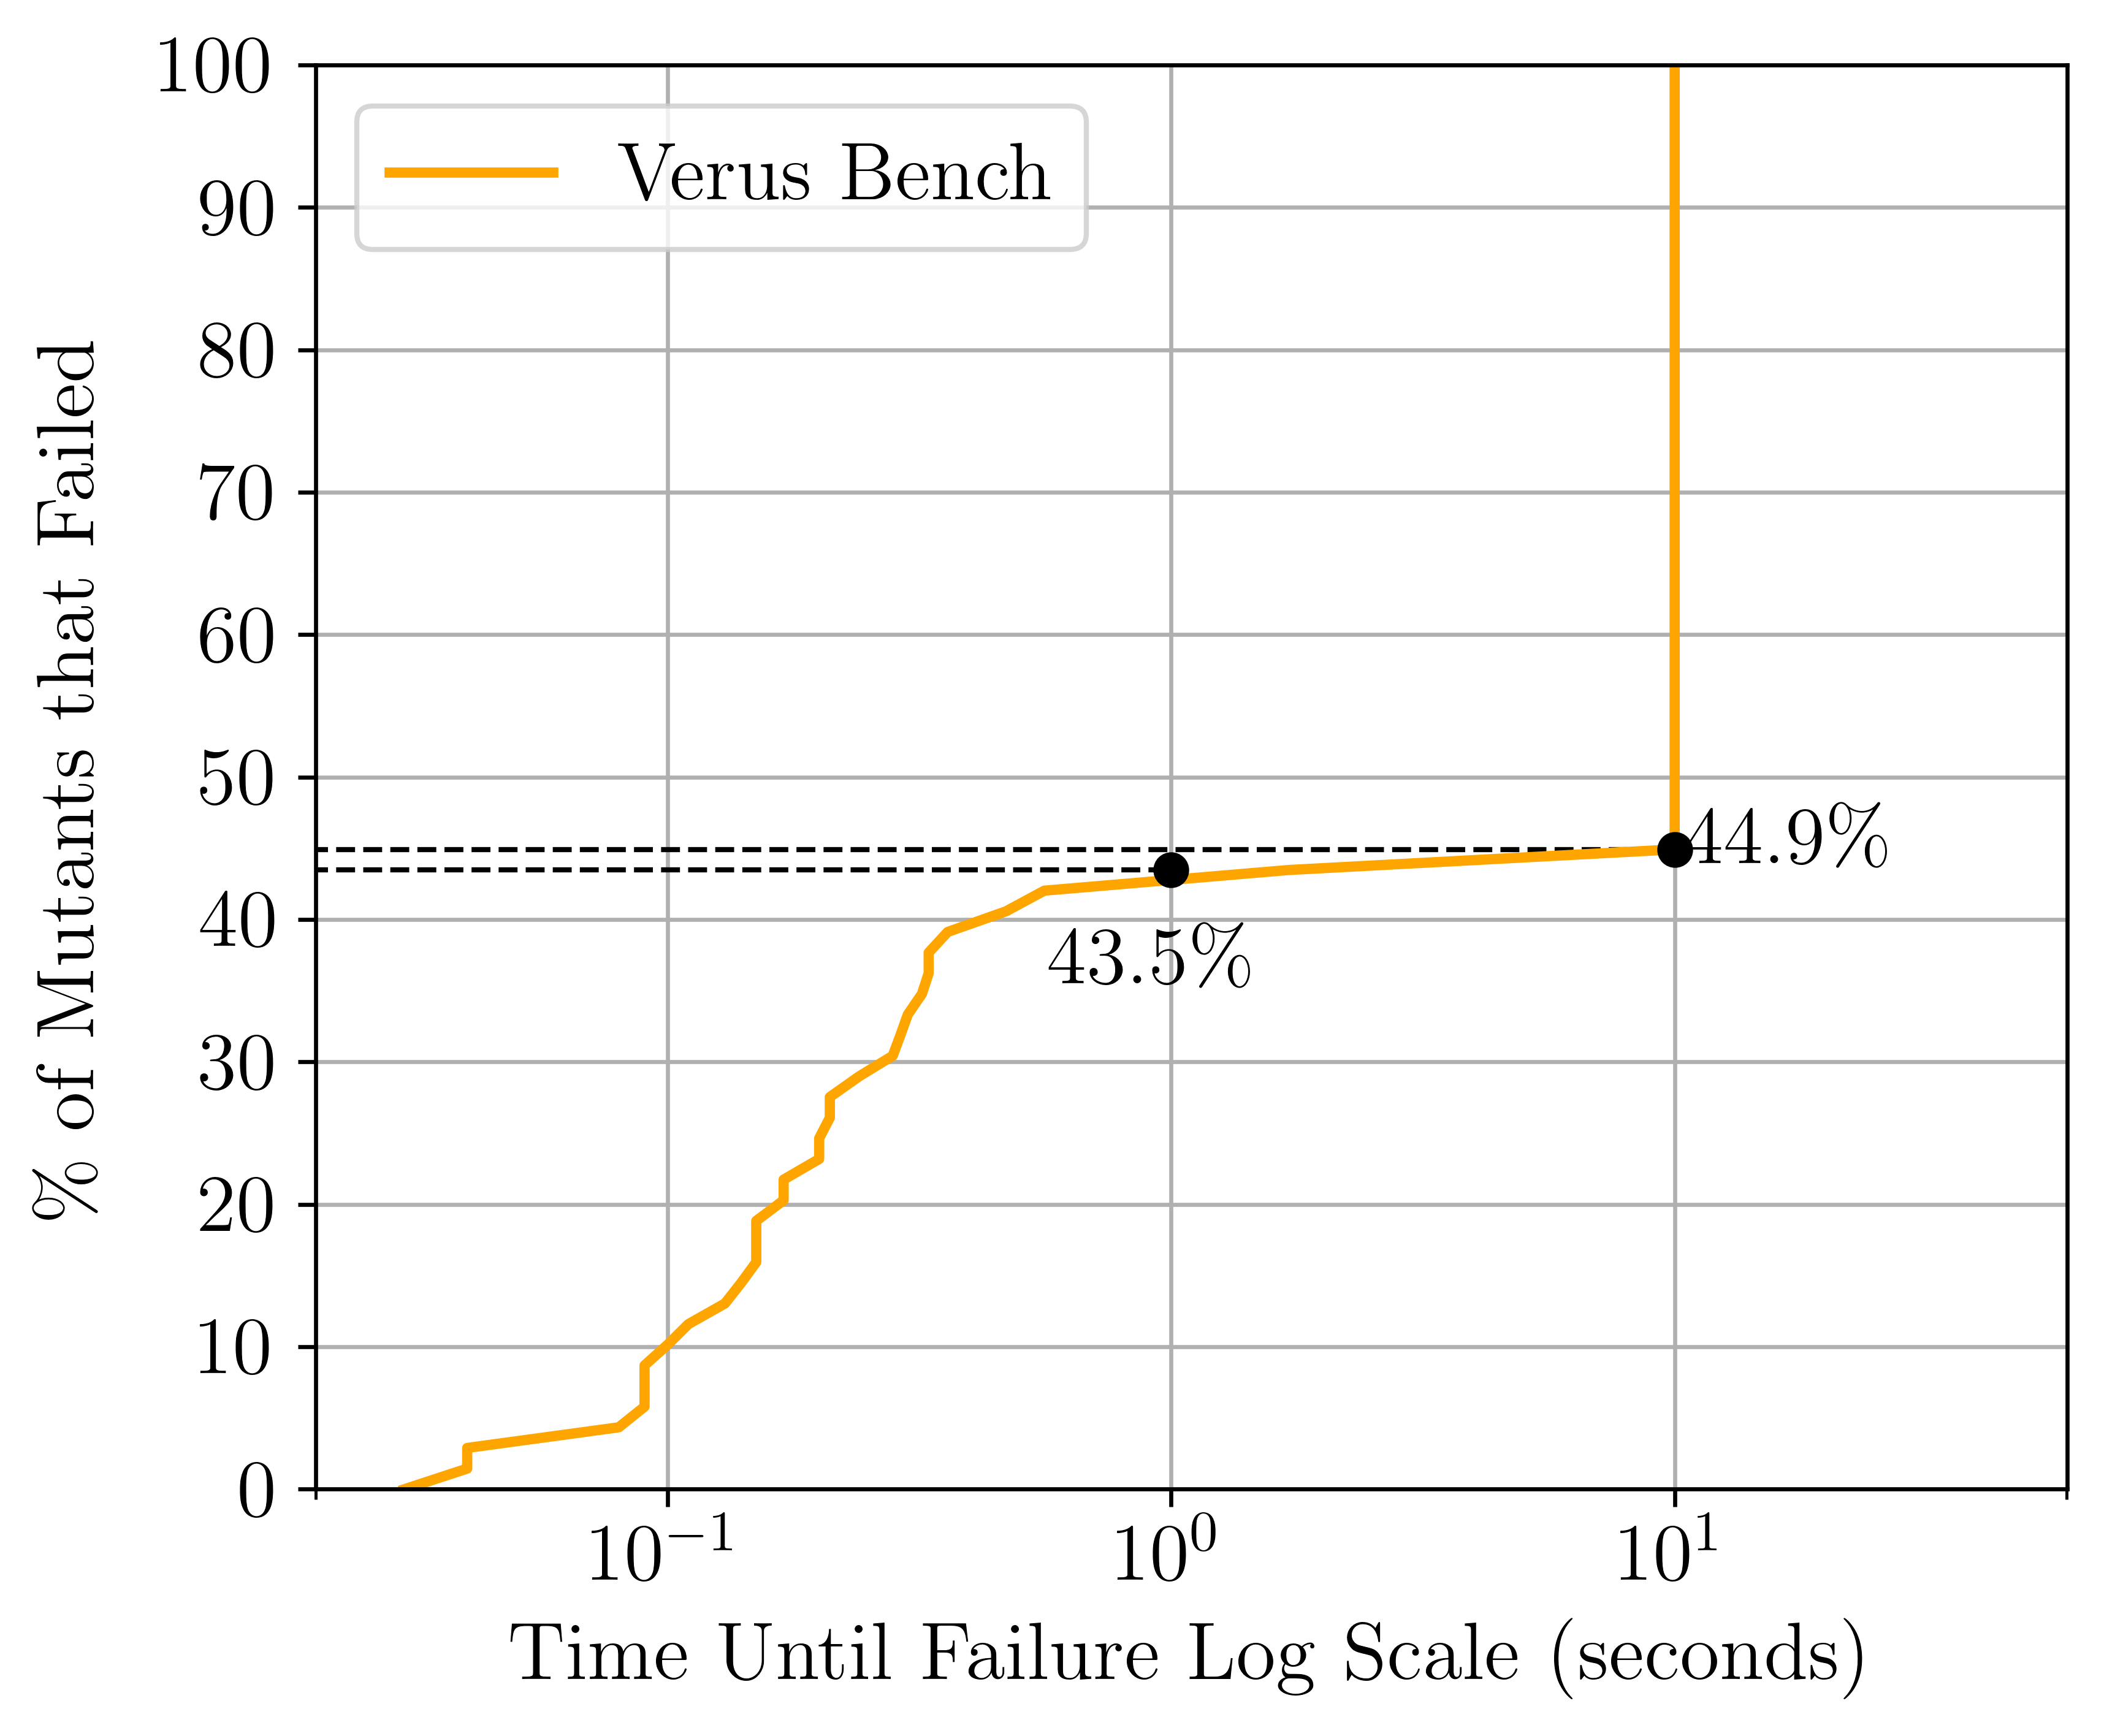
Experiment: Distinct Failure Modes
Notes:
Give the graph a lot of time
- just do one of Verus or Mariposa
Scripts are on 1905

Slide 27
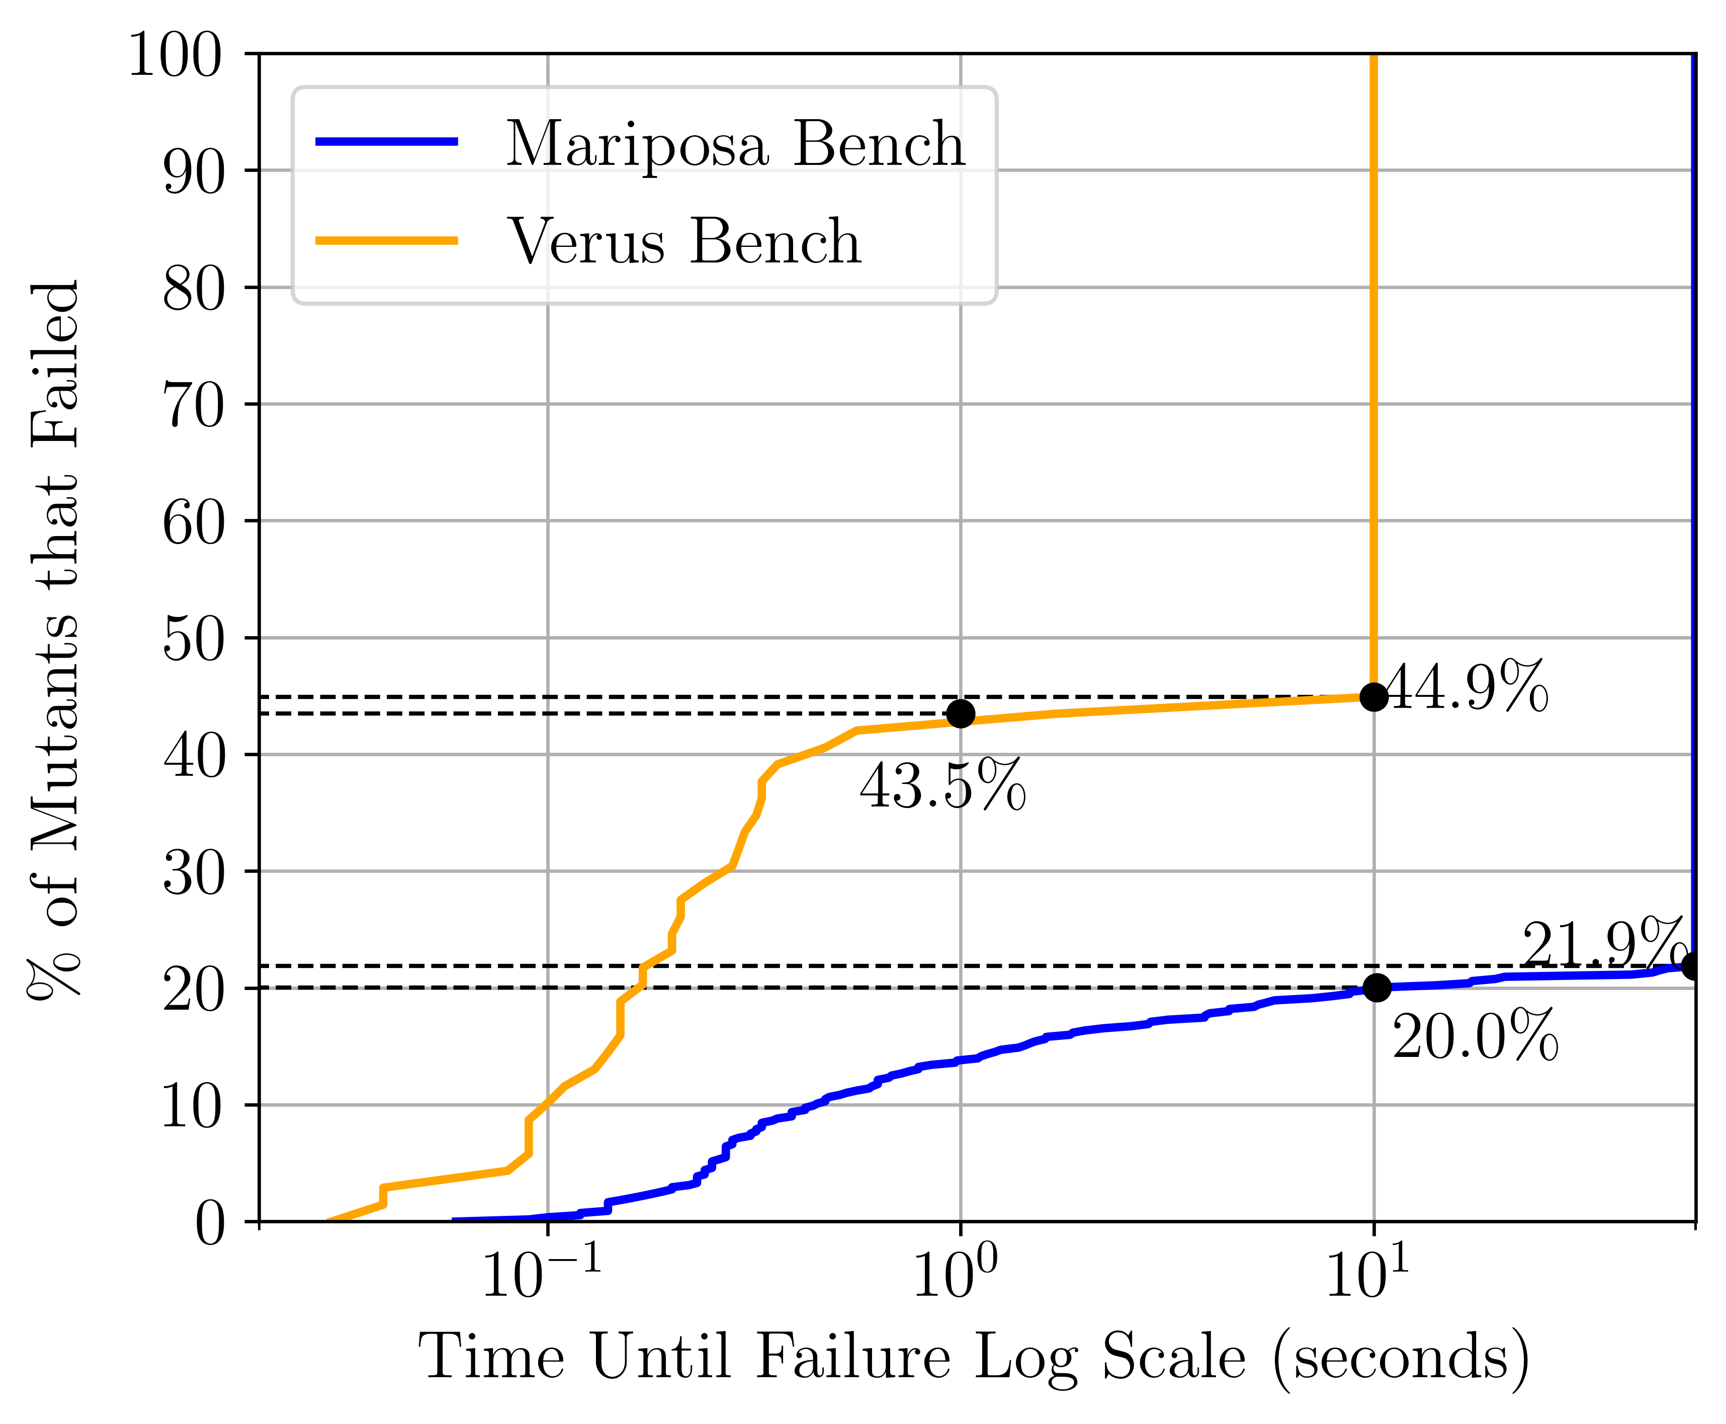
Experiment: Distinct Failure Modes
Notes:
Give the graph a lot of time
- just do one of Verus or Mariposa
Scripts are on 1905

Slide 28
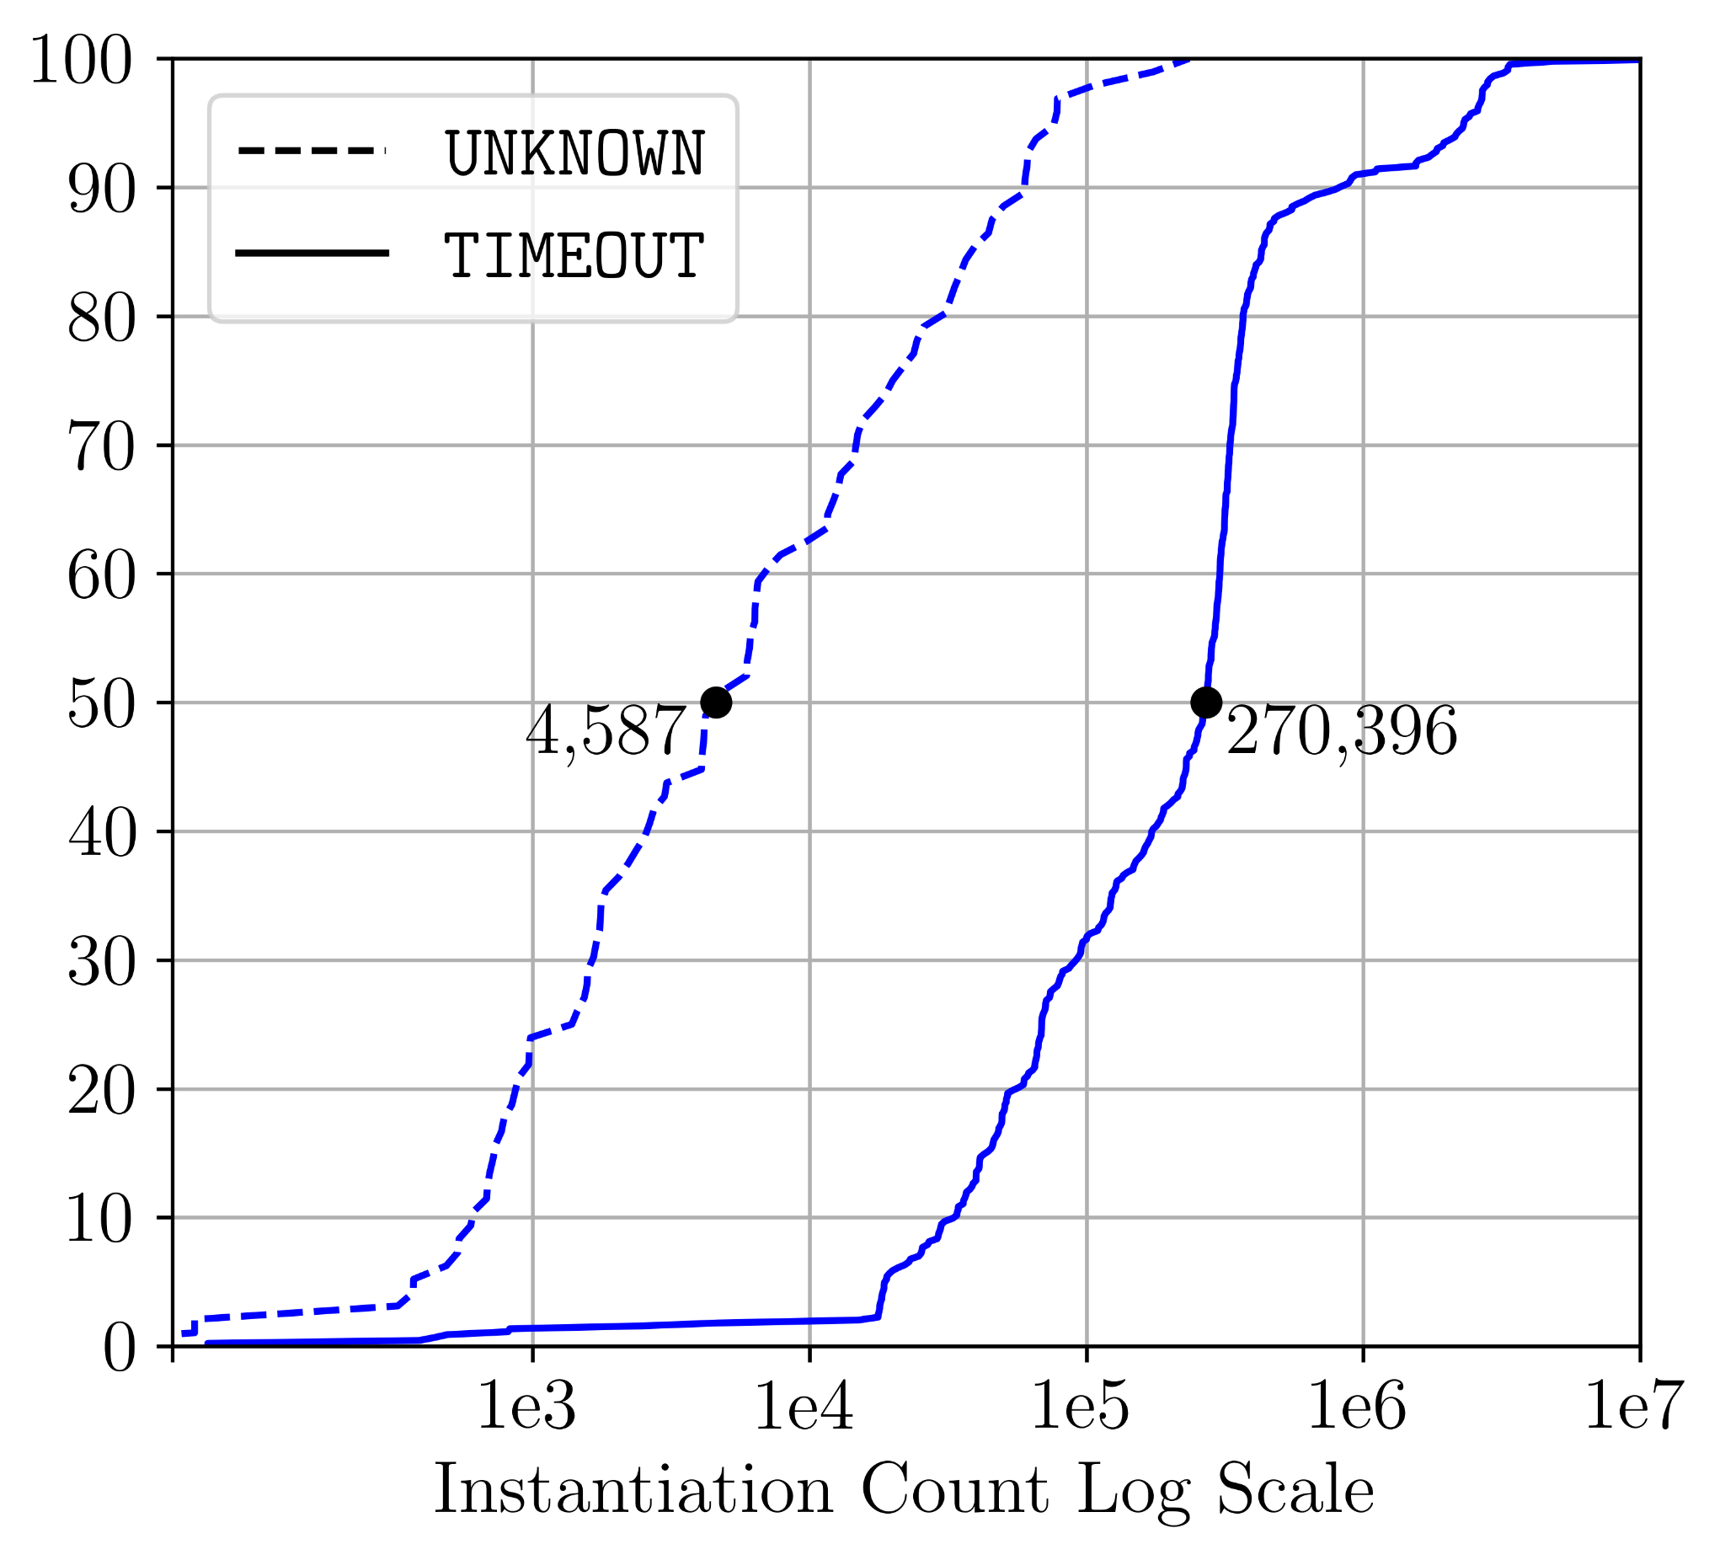
Experiment: Distinct Failure Modes
Notes:
Give the graph a lot of time
- just do one of Verus or Mariposa
Scripts are on 1905

Slide 29
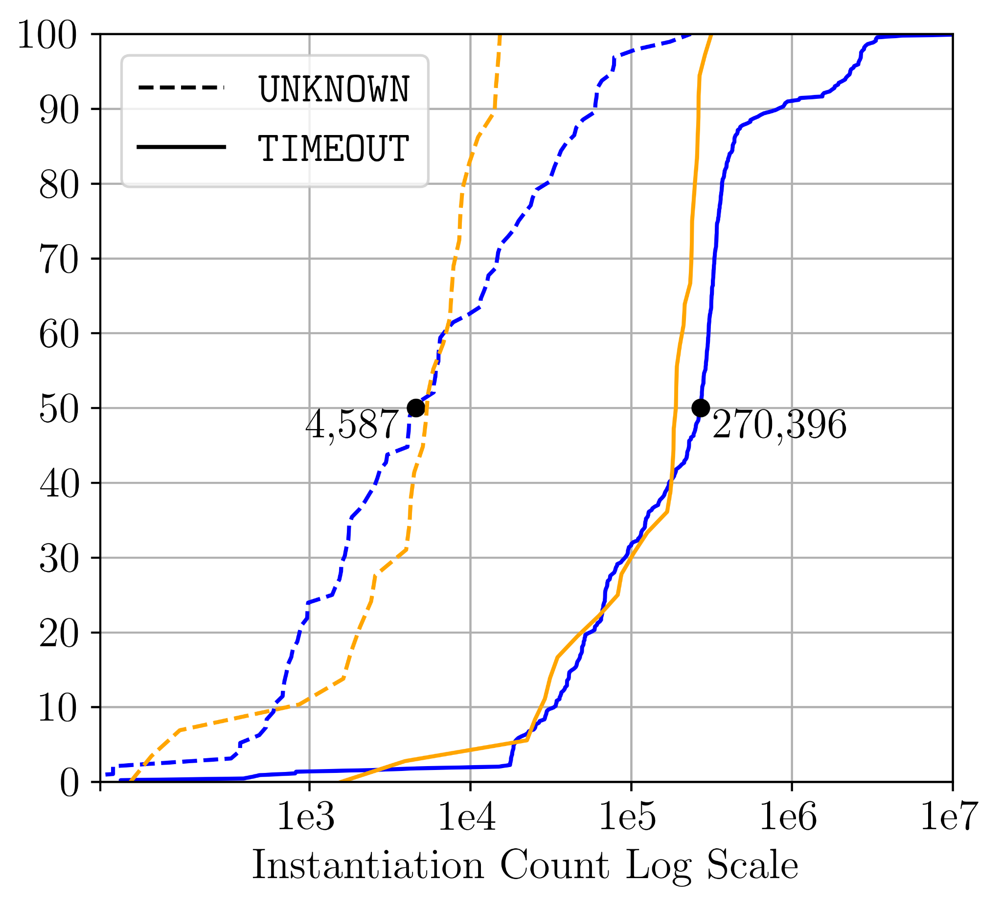
Experiment: Distinct Failure Modes
Notes:
Give the graph a lot of time
- just do one of Verus or Mariposa
Scripts are on 1905

Slide 30
Background
Measuring Instability
Cazamariposas
Query Edits
Preserve Verification Goal
Evaluation

Slide 31
Two Different Causes of Instability
Solver discovers too many instantiations
Solver misses instantiations
Solver-Discovered
Instantiations
Solver-
Discovered
Instantiations
Required
Instantiations
= ∅
Required
Instantiations
Output: Solver times out
Output: Solver returns “unknown”

Slide 32
Observation: Differential Behavior
UNKNOWN/TIMEOUT
Mutant 1
SMT Query
Mutant 2
SMT Solver
Mutant 3
UNSAT

Slide 33
Observation: Differential Behavior
~$ z3 mutant1.smt2 trace=true
UNKNOWN/TIMEOUT
Trace of Failure
Mutant 1
Solver-discovered instantiations
What went wrong?
SMT Query
SMT Solver
Mutant 3
Required instantiations
What is supposed to happen?
Compare the Quantifier Instantiations!
Proof of UNSAT
UNSAT
~$ z3 mutant3.smt2 proof=true

Slide 34
Cazamariposas: Edit-then-Test
SMT Query
Proof of UNSAT
Trace of Failure
Minor query edits (described soon) :
Retain the verification goal
Stabilize the query
Each is a singleton edit based on 1 quantified axiom.
Classify Unknown/Timeout
Query Editor
φ₀
φ₁
φ₂
φ_{N}
Edited
Query 1
Edited
Query 2
Edited
Query 3
Ranked
Query 1
Ranked
Query 2
Ranked
Query 3
Edited
Query N
Ranked
Query N
. . . . .
Take the best 10, by heuristic (discussed later)
Notes:
TODO: say that the edits are coming
-Visually permute them and have a ranking
- then everything after 10 we drop
- make this tangible (1 axiom out of how many)
- make a point that a high level, heuristics work off on dependencies of the graph
- add a slide after the end

Slide 35
Two Different Causes of Instability
Solver discovers too many instantiations
Solver misses instantiations
Solver-Discovered
Instantiations
Solver-
Discovered
Instantiations
Required
Instantiations
= ∅
Required
Instantiations
Output: Solver times out
Output: Solver returns “unknown”
Solution: Delete Over-instantiated Axiom
Solution: Instantiate Under-instantiated axiom

Slide 36
Instability Cause 1: Too many instantiations (Timeout)
Solver-
Discovered
Instantiations
Excessive
Instantiations
Proof
Instantiations
= ∅

Slide 37
Fix 1: Delete Over-Instantiated Axiom
Excessive
Instantiations
Proof
Instantiations
= ∅
Solver-
Discovered
Instantiations
= ∅
Delete the Axiom!
Notes:
TODO: Clarify that the instantiations don’t occur in the proof

Slide 38
Ranking Quantifiers 1: Over-Instantiation Case
Want to add quantifiers that are instantiated the most on failing mutants
(assert (forall ((x A)) (= (f x) (g x)) :pattern (f x)))
(= (f s) (g s))
( = (f t) (g t))
(= (f r) (g r))
(assert (forall ((x A)) (= (g x) (h x)) :pattern (g x)))
. . .
. . .
. . .
Notes:
Need to introduce pattern-based instantiation earlier
Use simple mathematical names

Slide 39
Instability Cause 2: Missing Instantiations (Quick Unknown)
Proof Instantiations
Solver-
Discovered
Instantiations
Notes:
Move to before graphs

Slide 40
Instability Cause 2: Missing Instantiations (Quick Unknown)
Missed Instantiations
Solver-
Discovered
Instantiations
Notes:
- Why are these missing? -> leave proof instantiations (call out missed)

Slide 41
Fix 2: Instantiate Under-Instantiated Axiom (Quick Unknown)
Missed Instantiations
Solver-
Discovered
Instantiations
Add all the missed instantiations!
Notes:
- say something about this

Slide 42
Fixing an Under-Instantiated Axiom (Quick Unknown)
Solver-
“Discovered”
Instantiations
Proof Instantiations
Missed Instantiations
Add all the missed instantiations!
Notes:
-

Slide 43
Ranking Quantifiers 2: Under-instantiation case
We pick quantifiers that are instantiated most frequently in successful proofs, but are missed in failing traces

Slide 44
Background
Causes of Instability
Two Types of Instability
Query Edits
Preserve Verification Goal
Evaluation

Slide 45
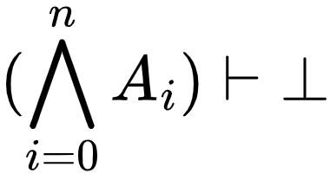
SMT Queries
(assert (forall ((x Poly)) (! (=> (has_ ...
...
(assert (forall ((bits Int) (x Poly)) (!...
(assert (forall ((bits Int) (x Poly)) (!...
(assert (forall ((x Int)) (! (= (str%fro...
(assert (forall ((x StrSlice)) (! (has_ ...
(assert (forall ((x@ tuple%0.)) (! (= x@...
(assert (not (=> (= temp_0_0~17@ (Mul b~...
(check-sat)
A_{n}
?
...
A4
A3
A2
A1
A0
Notes:
The solver cannot tell what is the goal.
Move this later: with the second time I do venn digrams (to justify soundness)

Slide 46
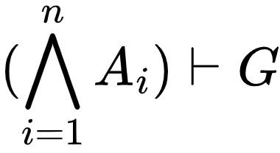
Observation: Goal-Axiom Divide
(assert (forall ((x Poly)) (! (=> (has_ ...
...
(assert (forall ((bits Int) (x Poly)) (!...
(assert (forall ((bits Int) (x Poly)) (!...
(assert (forall ((x Int)) (! (= (str%fro...
(assert (forall ((x StrSlice)) (! (has_ ...
(assert (forall ((x@ tuple%0.)) (! (= x@...
(assert (not (=> (= temp_0_0~17@ (Mul b~...
(check-sat)
A_{N}
?
...
A4
A3
Fix instability here!
?
A2
A1
A0
¬G
Goal assertion: always in the form of ¬G
Notes:
The solver cannot tell what is the goal.
Get rid of dotted circle (precise fixes motivated by trying to fix at source)

Slide 47
Repairing Instability
(assert (forall ((x Poly)) (! (=> (has_ ...
...
(assert (forall ((bits Int) (x Poly)) (!...
(assert (forall ((bits Int) (x Poly)) (!...
(assert (forall ((x Int)) (! (= (str%fro...
(assert (forall ((x StrSlice)) (! (has_ ...
(assert (forall ((x@ tuple%0.)) (! (= x@...
(assert (not (=> (= temp_0_0~17@ (Mul b~...
(check-sat)
(assert (forall ((x Poly)) (! (=> (has_ ...
...
(assert (forall ((bits Int) (x Poly)) (!...
(assert (forall ((bits Int) (x Poly)) (!...
(assert (forall ((x Int)) (! (= (str%fro...
(assert (forall ((x StrSlice)) (! (has_ ...
(assert (forall ((x@ tuple%0.)) (! (= x@...
(assert (not (=> (= temp_0_0~17@ (Mul b~...
(check-sat)
unstable
stable

Slide 48
Repairing Instability
(assert (forall ((x Poly)) (! (=> (has_ ...
...
(assert (forall ((bits Int) (x Poly)) (!...
(assert (forall ((bits Int) (x Poly)) (!...
(assert (forall ((x Int)) (! (= (str%fro...
(assert (forall ((x StrSlice)) (! (has_ ...
(assert (forall ((x@ tuple%0.)) (! (= x@...
(assert (not (=> (= temp_0_0~17@ (Mul ... (check-sat)
(assert (forall ((x Poly)) (! (=> (has_ ...
...
(assert (forall ((bits Int) (x Poly)) (!...
(assert (forall ((bits Int) (x Poly)) (!...
(assert (forall ((x Int)) (! (= (str%fro...
(assert (forall ((x StrSlice)) (! (has_ ...
(assert (forall ((x@ tuple%0.)) (! (= x@...
(assert (not (=> (= temp_0_0~17@ (Mul ... (check-sat)
No change to the verification goal
unstable
stable
Notes:
- make the crosse-through line much bolder

Slide 49
Background
Cause of Instability
Two Types of Instability
Query Edits
Preserve Verification Goal
Evaluation

Slide 50
Evaluation: Identifying the Stabilizing Edits (Top 10)
Notes:
highlight future work in its own slide
Confusing to someone who doesn’t know it
Fix the legend (fixed), move to side (remove white boxes, can get rid of legend)
Walk through this
Shake improves results by about 40% (but it does not provide a precise fix)

Slide 51

Cazamariposas
Ranked Query 1
Edited Query 0
stable
. . .
SMT Query
Edited
Query 1
Future Work: realize these edits at the Verifier level
Ranked Query 10
Mariposa
unstable
Query Editor
. . .
Edited
Query N
Notes:
Todo: add more info about the ranking in extra slides
Todo: fix the animations
If I cut down motivation, then can I talk about heuristics
“tiny amount of manual effort” -> avoid judgement adjectives, like tiny

Slide 52
Future Work: Realize Edits at the Verifier Level
Currently:
Wow let me incorporate this SMT fix!
Cazamariposas
Future:
Wow this fix has been added at the source level!
Cazamariposas

Slide 53
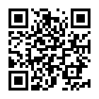
Takeaways
Thank you ☺
SMT instability is an impediment to large-scale verification
Two instability causes: Solver times out or returns a quick-unknown
Instability can often be blamed on a single quantifier
Correspond to simple changes at the source-level
Code:
Contact: amarshah@cmu.edu
Notes:
TODO: check that the QR code works

Slide 54





Thank you ☺
Yi Zhou
Amar Shah
Zhengyao Lin
Marijn Heule
Bryan Parno
Contact: amarshah@cmu.edu
TODO: Insert QR Code to get to Mariposa website
Notes:
TODO: Insert QR Code to get to Mariposa website

Slide 55
Evaluation: Minimal Rank of a Fix
Notes:
Might look like we are composing edits
Maybe replace with one shot success rate

Slide 56
How to “Fix” a Mixed Case?
Solver-discovered
instantiations
Proof Instantiations
Add Assertions
+ Delete the Axiom

Slide 57
How to “Fix” a Mixed Case?
Proof Instantiations
=
Solver “Discovered”
Instantiations
Add Assertions
+ Delete the Axiom

Slide 58
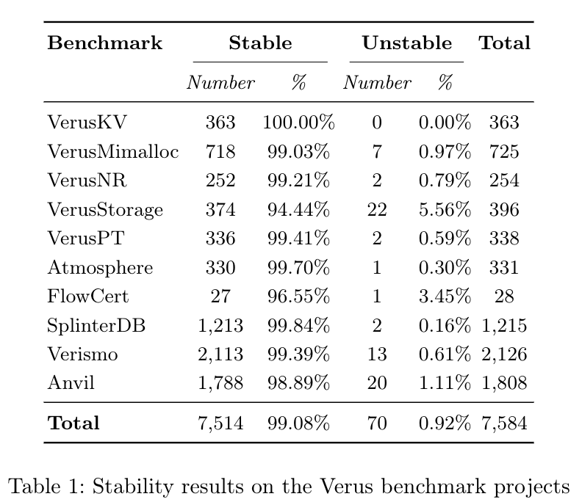
More information about the Verus Benchmarks
We curate a new benchmark set comprised of SMT queries from the following nine Verus verification projects. – VerusKV, VerusMimalloc, VerusNR, VerusStorage, VerusPT were all from the Verus systems paper – Atmosphere is a full-featured microkernel. – VerusSplinterDB is a key-value store designed around a B-epsilon tree. – Verismo is a security module for confidential VMs [46]. – Anvil is a tool for verifying Kubernetes controllers with Verus The project verifies three controllers: ZooKeeper, RabbitMQ, and FluentBit. – FlowCert is a tool for the translation validation of dataflow programs .

Slide 59
Changes at the source level
Deleting quantifiers corresponds to using hide(...) at the source level
#[verifier(spinoff_prover)]
proof fn lemma_from_after_get_stateful_set_step_to_after_update_stateful_set_step(
spec: TempPred<RMQCluster>,
rabbitmq: RabbitmqClusterView,
resp_msg: RMQMessage
)
requires
...
ensures
...
{
...
}
#[verifier(spinoff_prover)]
proof fn lemma_from_after_get_stateful_set_step_to_after_update_stateful_set_step(
spec: TempPred<RMQCluster>,
rabbitmq: RabbitmqClusterView,
resp_msg: RMQMessage
)
requires
...
ensures
...
{
hide(make_stateful_set);
...
}

